Slide 1

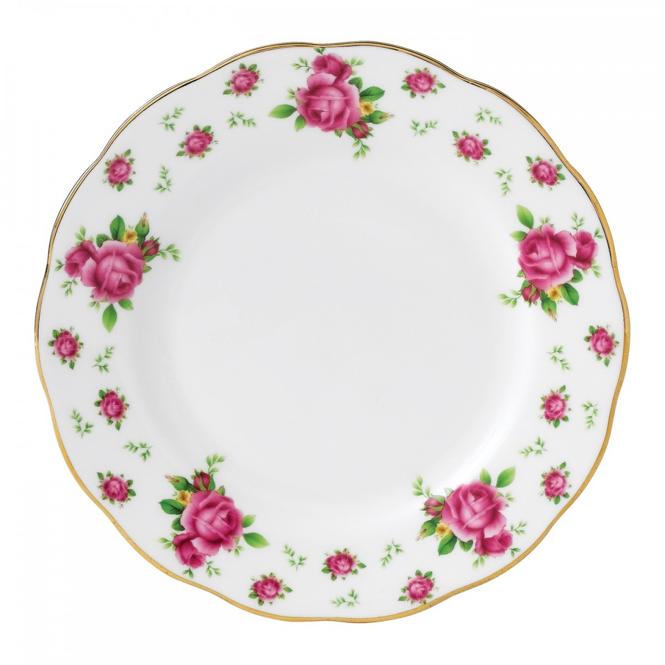

Templates in Ten Plates
Rik Hepworth
Microsoft MVP (Azure)
IT Director, Black Marble
@rikhepworth
blogs.blackmarble.co.uk

Slide 2
Templates are Azure’s Infrastructure as Code
They are declarative
They are idempotent
They allow deployment of complex resources
They can be nested (call other templates)
You can do clever stuff with sequencing
They are part of a healthy balanced DevOps diet

Slide 3
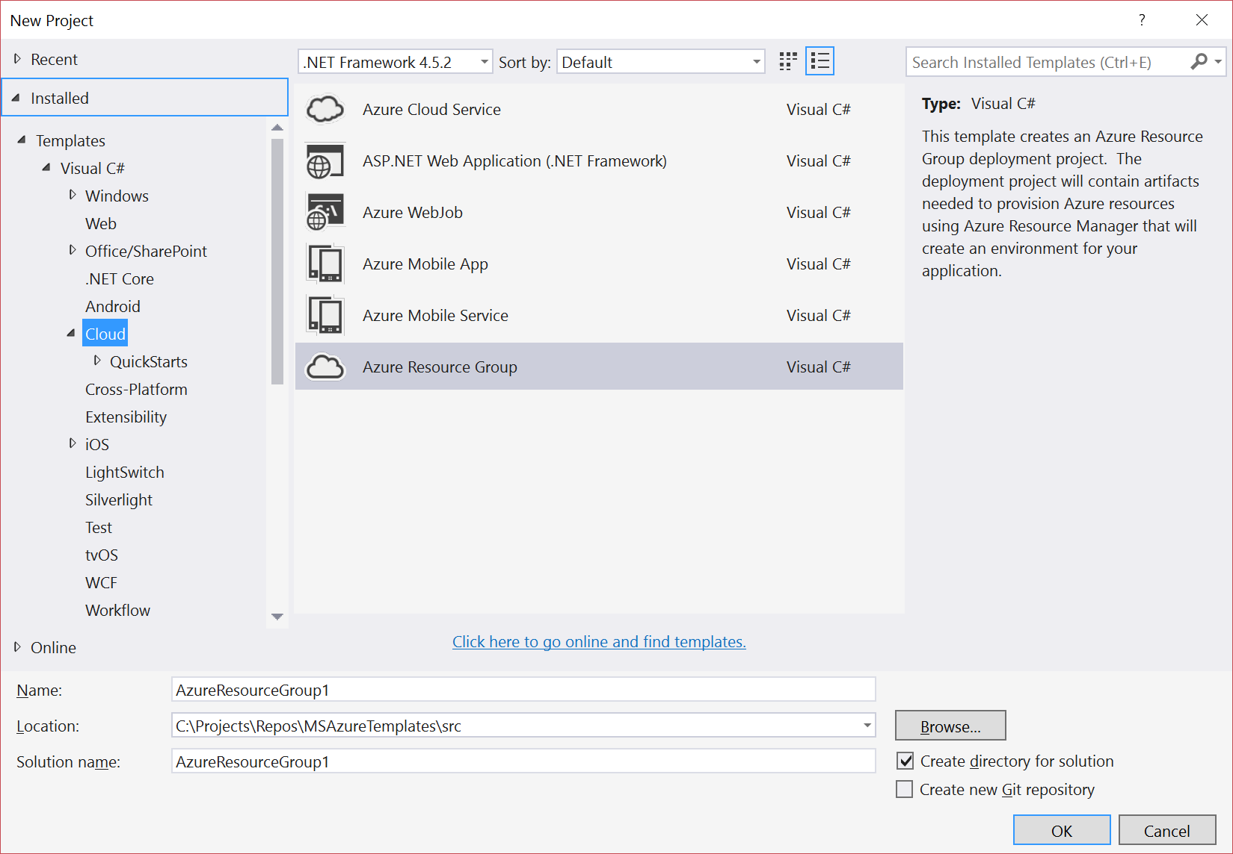
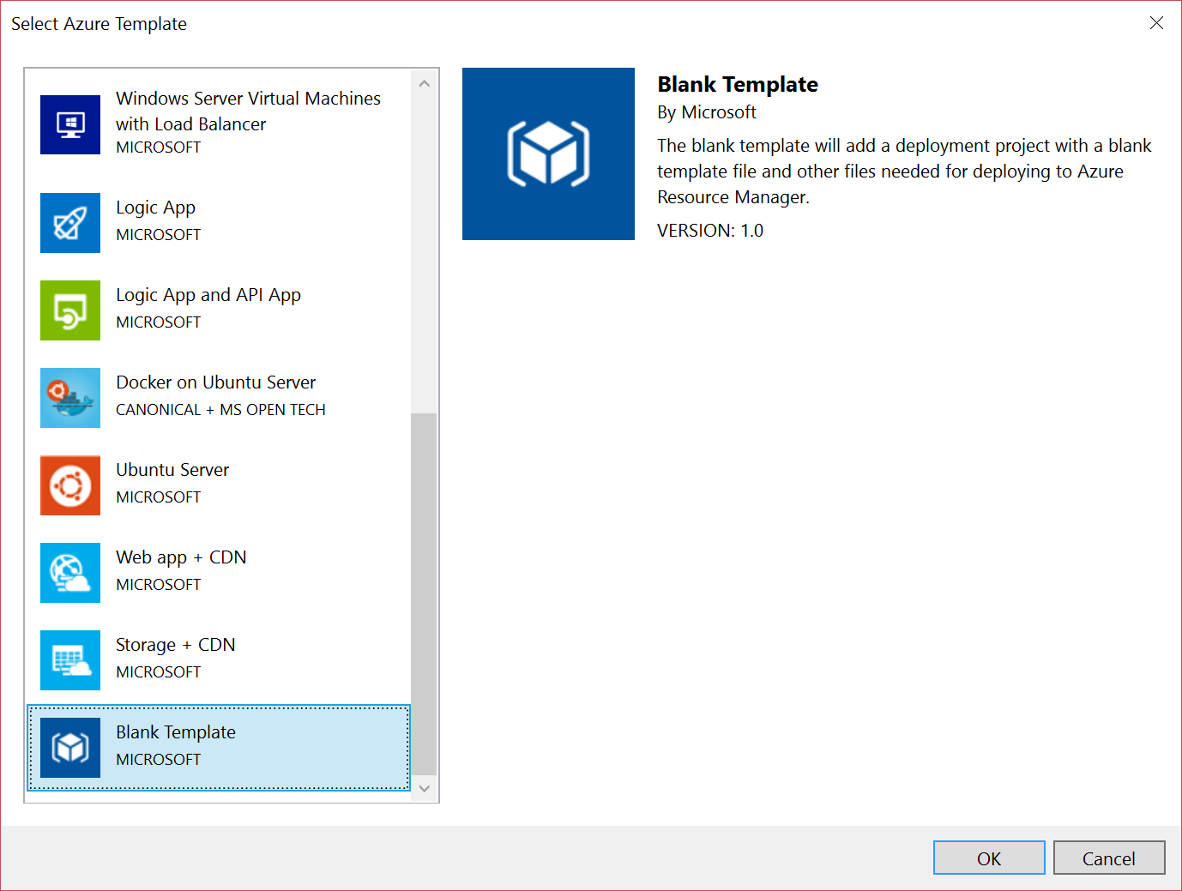
Create and edit them in Visual Studio
Yes, you can use Visual Studio Code, but the Azure SDK tooling is better in VS

Slide 4
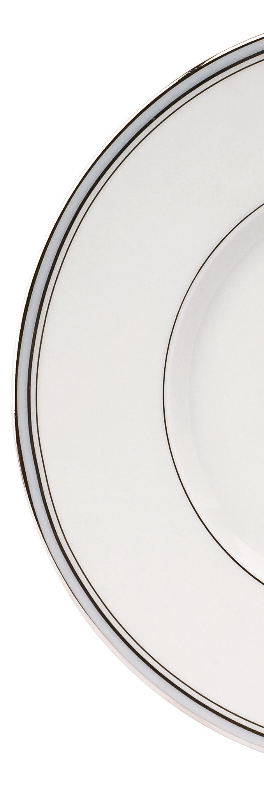
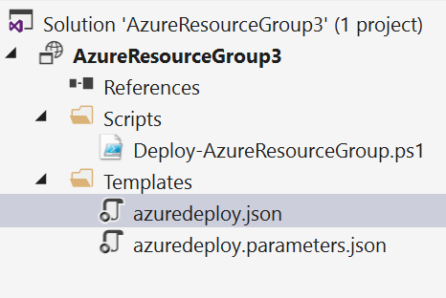
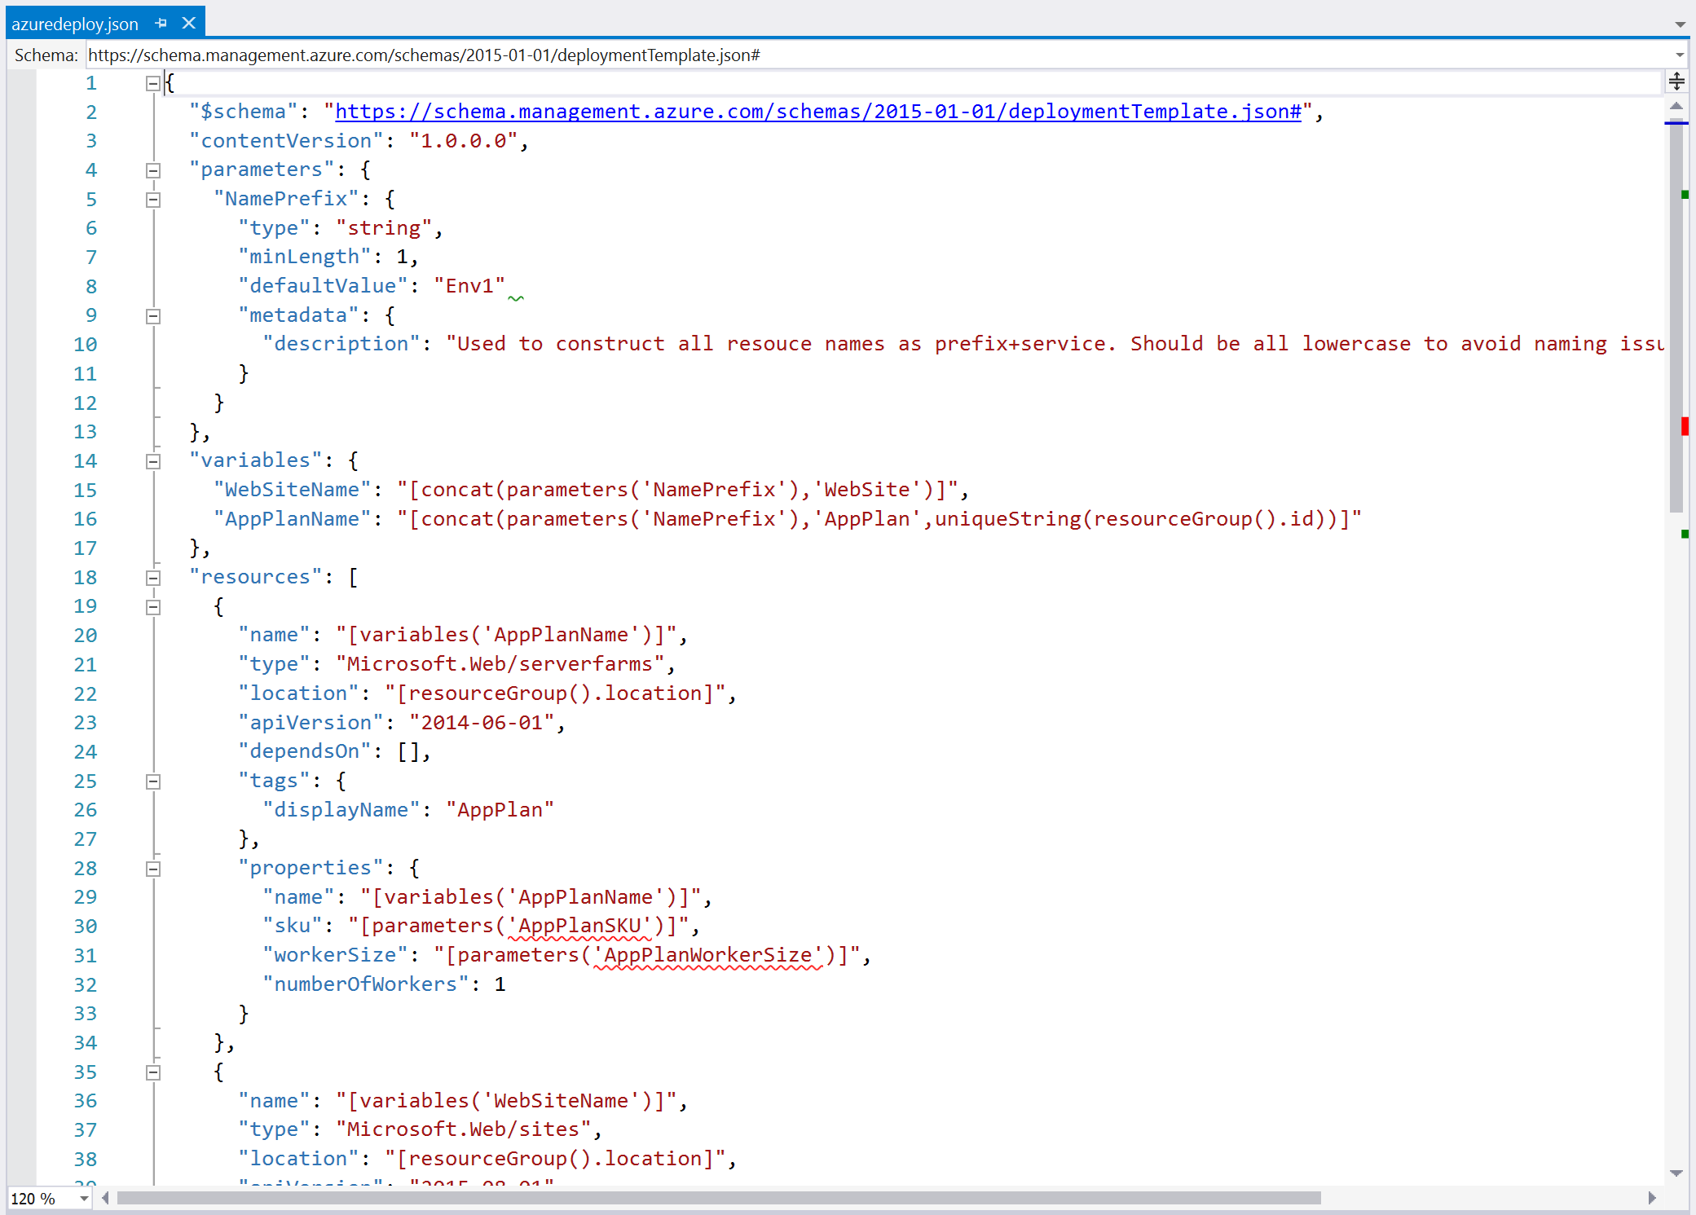
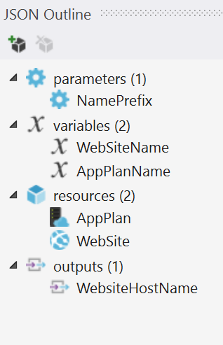
Templates are JSON format
And have four sections, easily manged in the JSON outline pane

Slide 5

Resources are the things you want to deploy
"resources": [
{
"name": "[variables('AppPlanName')]",
"type": "Microsoft.Web/serverfarms",
"location": "[resourceGroup().location]",
"apiVersion": "2014-06-01",
"dependsOn": [],
"tags": {
"displayName": "AppPlan"
},
"properties": {
"name": "[variables('AppPlanName')]",
"sku": "[parameters('AppPlanSKU')]",
"workerSize": "[parameters('AppPlanWorkerSize')]",
"numberOfWorkers": 1
}
}
]

Slide 6

Parameters allow deploy-time settings
"parameters": {
"NamePrefix": {
"type": "string",
"minLength": 1,
"defaultValue": "Env1"
"metadata": {
"description": "Used to construct all resource names as prefix+service. Should be all lowercase to avoid naming issues"
}
}
}

Slide 7
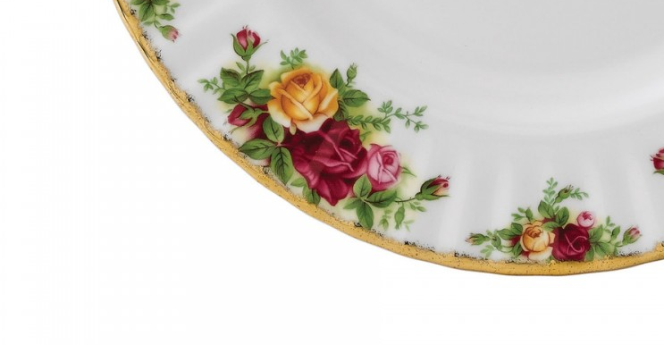
Variables are really, really useful
"variables": {
"WebSiteName": "[concat(parameters('NamePrefix'),'WebSite')]",
"AppPlanName": "[concat(parameters('NamePrefix'),'AppPlan',uniqueString(resourceGroup().id))]",
"RedisCache": {
"Name": "[concat(parameters('NamePrefix'),'Redis',uniqueString(resourceGroup().id))]",
"SKUName": "Basic",
"SKUFamily": "C",
"SKUCapacity": 0
}
}

Slide 8
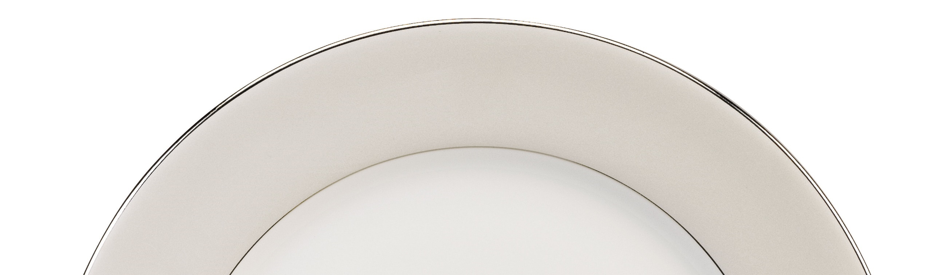
Outputs let you return values
"outputs": {
"WebsiteHostName": {
"value": "[reference(resourceId('Microsoft.Web/sites',variables('WebSiteName'))).hostNames[0]]",
"type": "string"
}
}

Slide 9
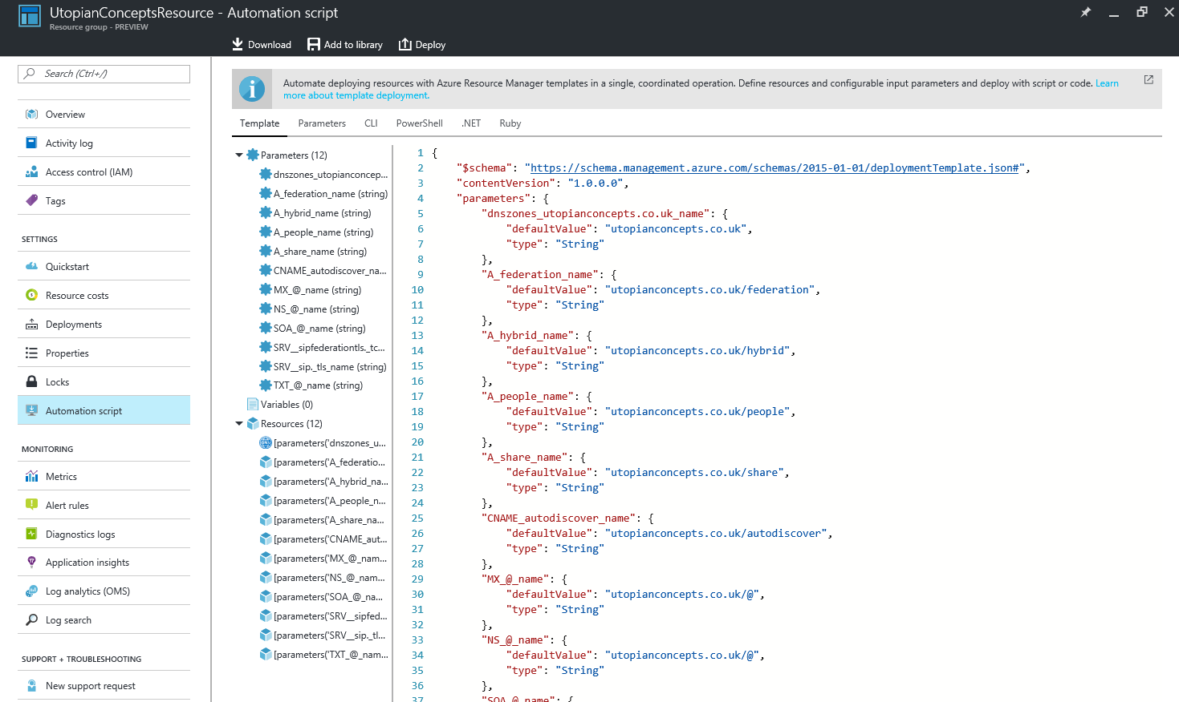
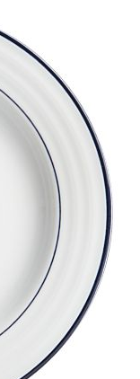
Export your existing stuff as a template

Slide 10
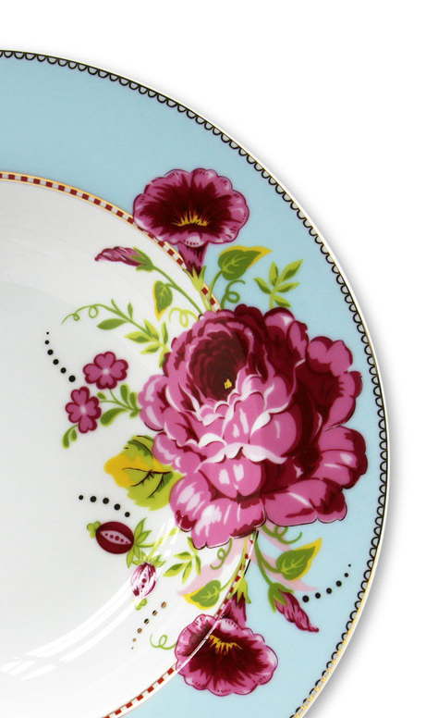
Useful Links
My Blog http://blogs.blackmarble.com/blogs/rhepworth
Azure QuickStart Templates https://github.com/Azure/azure-quickstart-templates
http://azure.microsoft.com/en-us/documentation/templates/
ARM Template Documentation https://msdn.microsoft.com/en-us/library/azure/dn835138.aspx
Azure Resource Explorer https://resources.azure.com/
“Azure Resource Manager DevOps Jumpstart” https://www.microsoftvirtualacademy.com/en-US/training-courses/azure-resource-manager-devops-jump-start-8413

